Slide 1
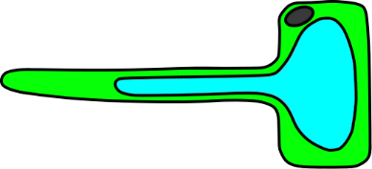
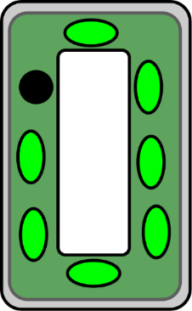
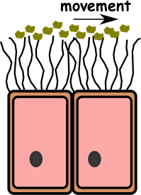
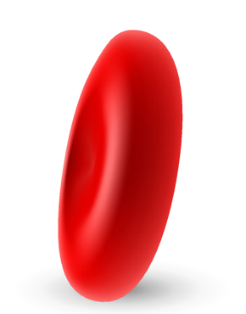
Write down the date and today’s title
CELLS
DO IT NOW; below are six specialised cells. Write down the following names and choose the letter that you think is correct. Sperm cell, Muscle cell, Palisade cell, Red blood cell, Root hair cell, Cilia cell.
Palisade cell
B.
E.
Cilia cell
A.
Sequence on click
in slide show.
Muscle cell
Root hair cell
C.
D.
F.
Red blood cell
Sperm cell
Stretch
Write down the two statements below and put the letter that you think is correct next to the statement.
These cells help clear the lungs of mucus and dust, they have hairs that move.
These cells can stretch and contract.
Can you explain what any of the others do?
Stretch
Write down the two statements below and put the letter that you think is correct next to the statement.
These cells help clear the lungs of mucus and dust, they have hairs that move. F. Cilia Cell
These cells can stretch and contract.
Can you explain what any of the others do?
Stretch
Write down the two statements below and put the letter that you think is correct next to the statement.
These cells help clear the lungs of mucus and dust, they have hairs that move. F. Cilia Cell
These cells can stretch and contract. B. Muscle Cell
Can you explain what any of the others do?

Slide 2
SUMMARY
Cells are the tiny individual units of life that make up larger organisms.
Plant and animal cells are made from slightly different organelles. These are the specialised structures that make up the cell.
Cells are very small and most can only be seen under a microscope.
Cells are specialised to do a particular job.
Cells group together to form tissue, tissues can form organs, organs can work together to form an organ system. Organ systems can combine to form organisms.

