Slide 1
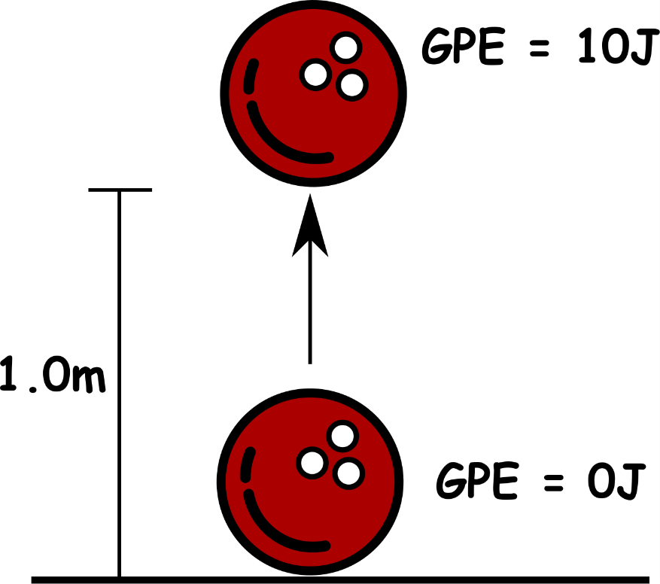
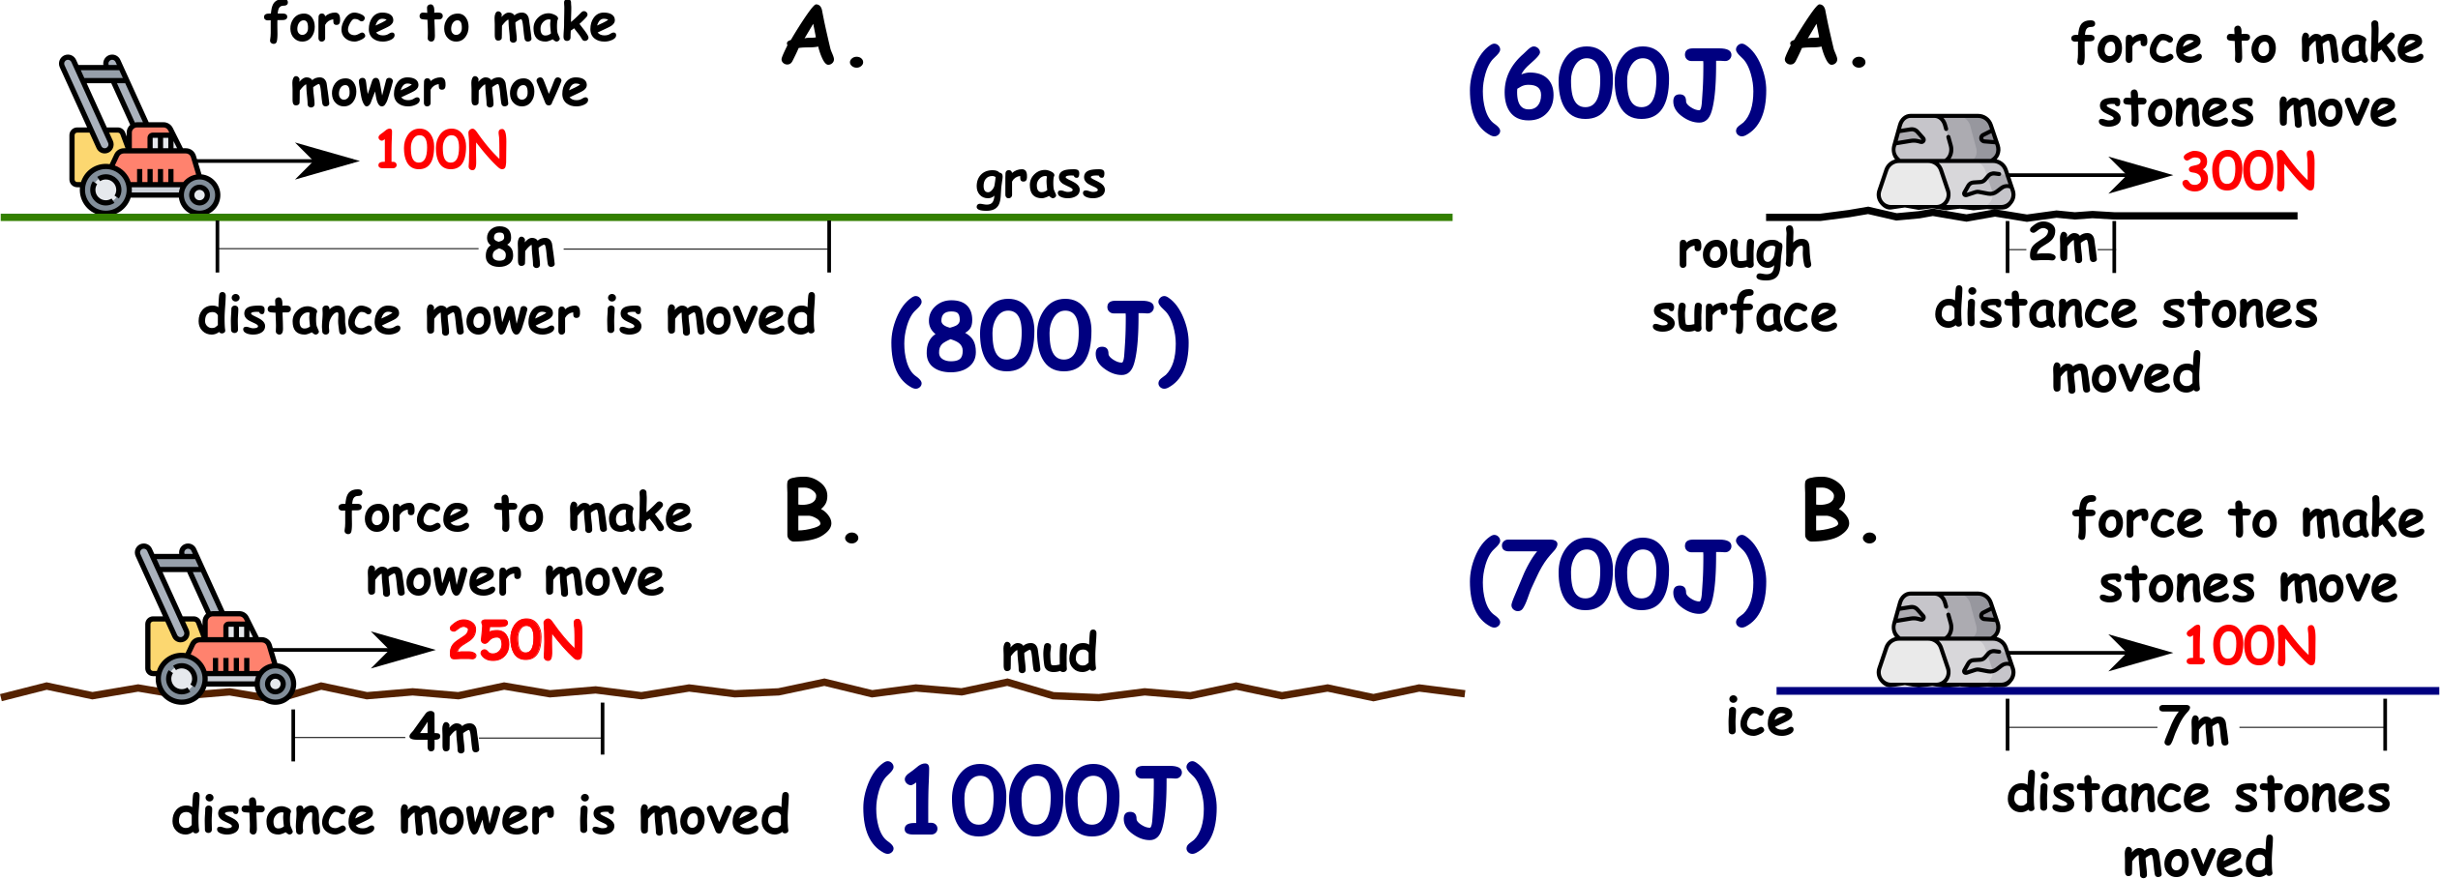
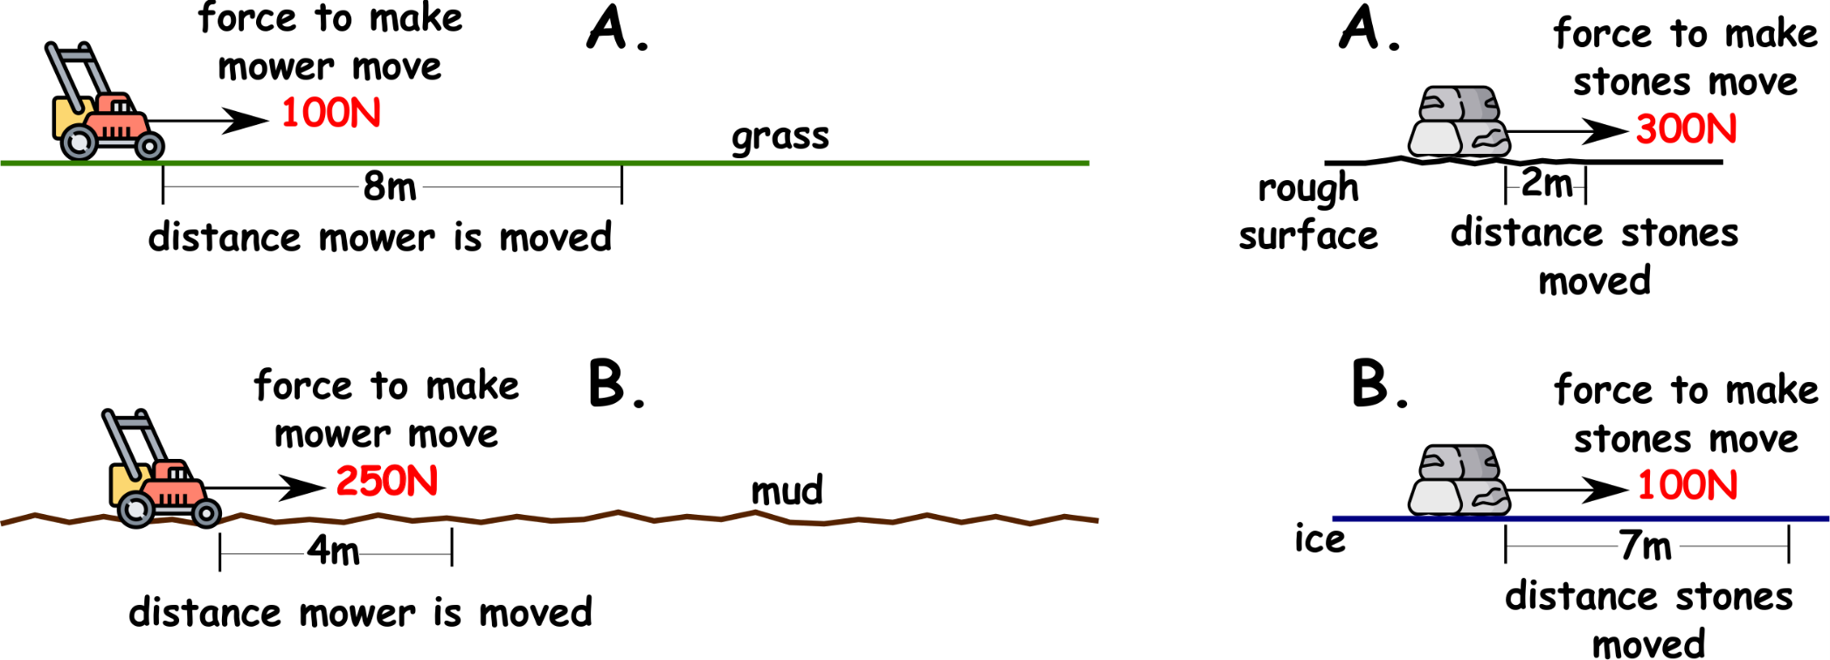
Write down the date and today’s title
WORK AND ENERGY
DO IT NOW; The energy required to move something can be calculated by multiplying force by distance. Calculate the energy required to move the mower and stones in A. and B. below (multiply force x distance).
Sequence on click
in slide show.
Stretch
What are we working against in the examples? TIRICFON
Where is the energy going? If we lift a bowling ball, what are we working against? GVITRAY
Where is the energy going?
Stretch
What are we working against in the examples? FRICTION
Where is the energy going? If we lift a bowling ball, what are we working against? GVITRAY
Where is the energy going?
Stretch
What are we working against in the examples? FRICTION
Where is the energy going? Converted to heat.
If we lift a bowling ball, what are we working against? GVITRAY
Where is the energy going?
Stretch
What are we working against in the examples? FRICTION
Where is the energy going? Converted to heat.
If we lift a bowling ball, what are we working against? GRAVITY
Where is the energy going?
Stretch
What are we working against in the examples? FRICTION
Where is the energy going? Converted to heat.
If we lift a bowling ball, what are we working against? GRAVITY
Where is the energy going? Increases the GPE of the ball.
Notes:
See slide show for sequence.

Slide 2
SUMMARY
The work done by a force is equal to the energy transferred.
Work done (joules) = Force (N) x Distance moved (m)
Work done against gravity is equal to the GPE gained by the object raised.
Work done against friction ends up as heat (like rubbing your hands).
If a force speeds an object up the work done can increase the kinetic energy of the object.

