Slide 1
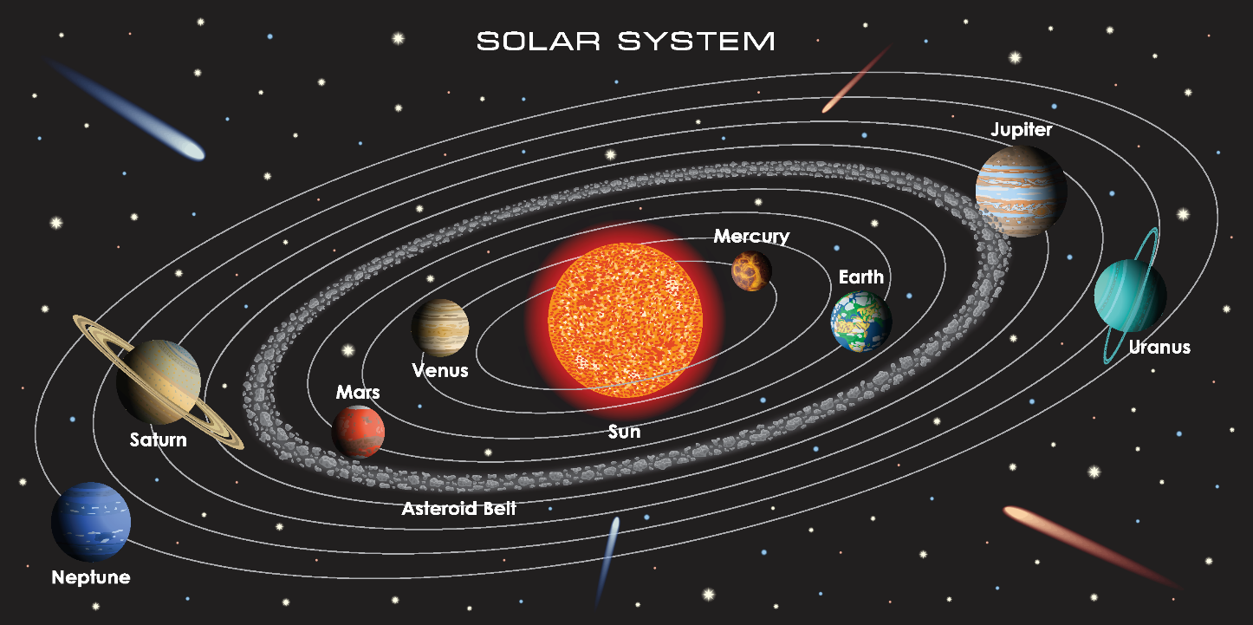
Write down the date and today’s title
OUR SOLAR SYSTEM, GALAXIES AND THE UNIVERSE
DO IT NOW; Write down the order of the planets starting with the planet closest to the sun.
Sequence on click
in slide show.
 | Earth | Saturn | Mercury | Mars | Neptune | Venus | Uranus | Jupiter
Orbit time (earth years) | 1 | 30 | 0.2 | 2 | 160 | 0.6 | 84 | 12
Watch
Mercury completes five orbits for earth’s one. Can you count them?! What’s missing?
Stretch
The ‘jumbled’ table tells us how long each planet takes to go round the sun once, the orbit time. Use your do it now to write a sentence describing the pattern.
Stretch
The further the planet is from the sun the longer it takes to orbit.
Notes:
Questions appears in slide show.

Slide 2
SUMMARY
Our solar system is made up of eight planets held in elliptical orbits around the sun by the pull of gravity.
Our sun is one of billions of stars in our own galaxy called the milky way.
A light year is a measure of distance. It is the distance travelled by light in one year.
Our nearest star is Alpha Centauri, 4.4 light years away. The milky way galaxy is 100,00 light years across.
The universe is all know space and matter. It contains billions of galaxies.

