Slide 1
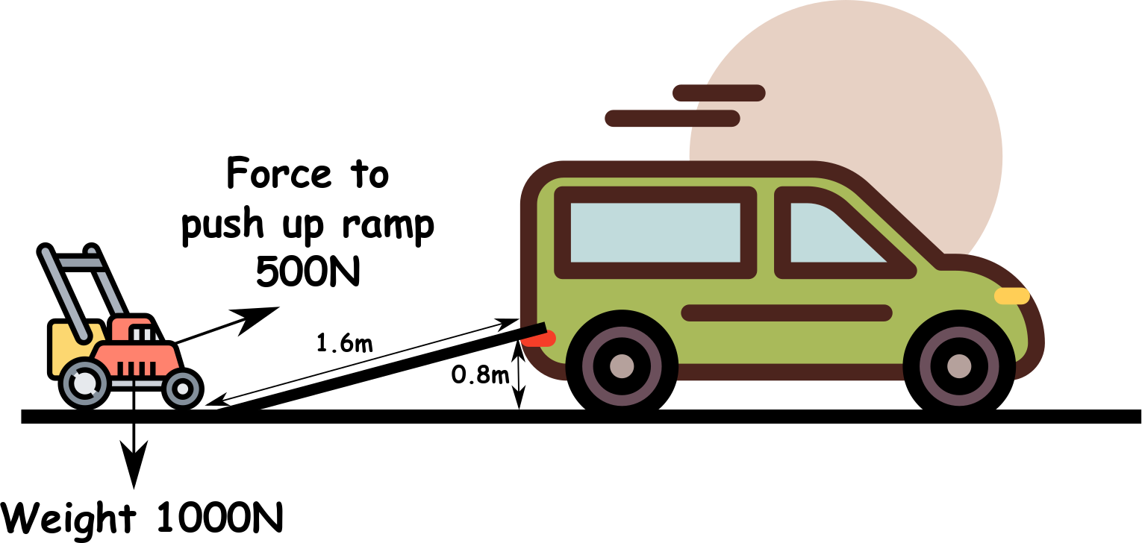
Write down the date and today’s title
SIMPLE MACHINES
DO IT NOW; Write down as many ‘things’ that you can think of that makes our lives easier i.e. machines (clue there are three below).
Sequence on click
in slide show.
Stretch
How much force would it take to lift the lawn mower straight into the van without the ramp?
What would happen if the ramp was longer?
What do lorries have at the back to help get goods on and off?
Stretch
How much force would it take to lift the lawn mower straight into the van without the ramp? 1000N
What would happen if the ramp was longer?
What do lorries have at the back to help get goods on and off?
Stretch
How much force would it take to lift the lawn mower straight into the van without the ramp? 1000N
What would happen if the ramp was longer? Smaller force for longer
What do lorries have at the back to help get goods on and off?
Stretch
How much force would it take to lift the lawn mower straight into the van without the ramp? 1000N
What would happen if the ramp was longer? Smaller force for longer
What do lorries have at the back to help get goods on and off?
A lift powered by a motor
Notes:
Answers can be faded in in the slide show.

Slide 2
SUMMARY
A machine makes doing a job easier.
Machines don’t give us something for nothing, i.e. they don’t break conservation of energy.
Simple machines include things like;
Levers, these use a force that is a long way from the pivot on one side to create a much larger force on the other side.
Ramps (inclines), these allow us to gradually ‘lift’ objects with a smaller force for a longer time.
Pulleys, these allow us to lift heavy objects straight up by combining pulleys to reduce the force needed, but for longer.

