Slide 1
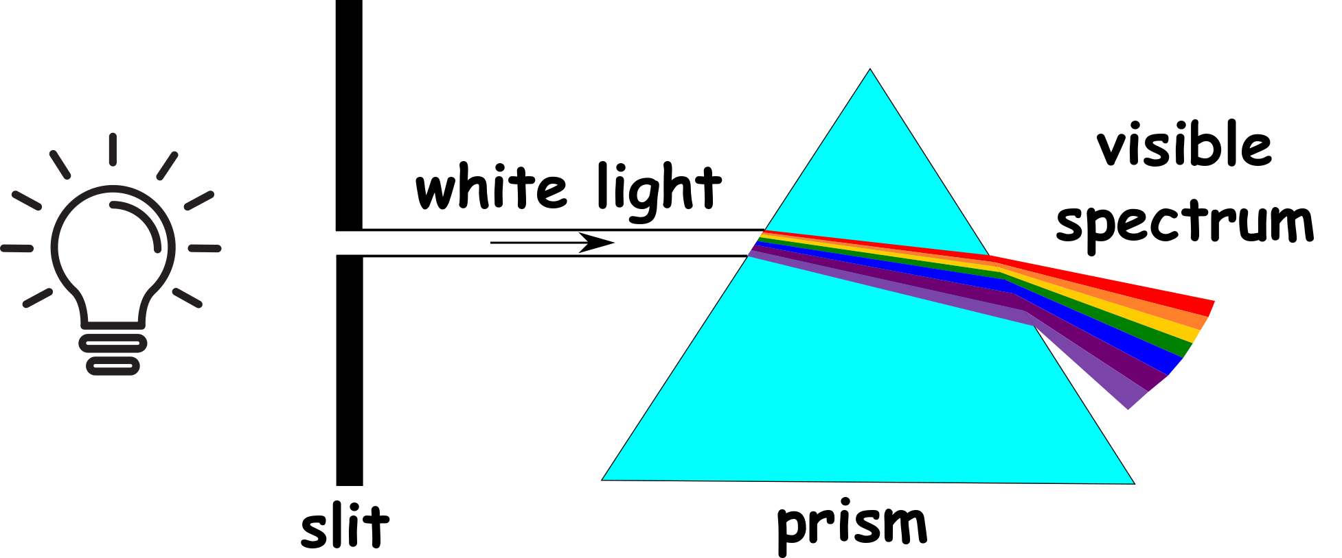
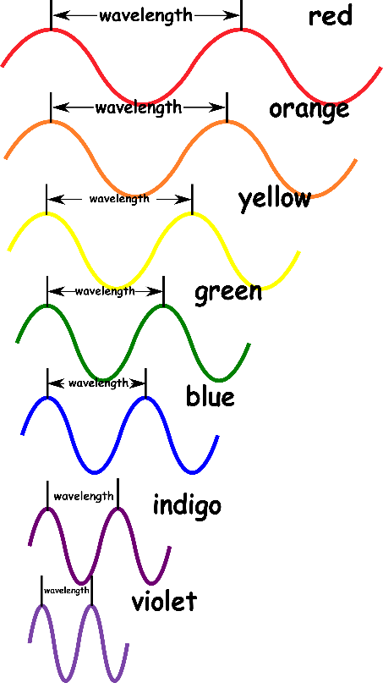
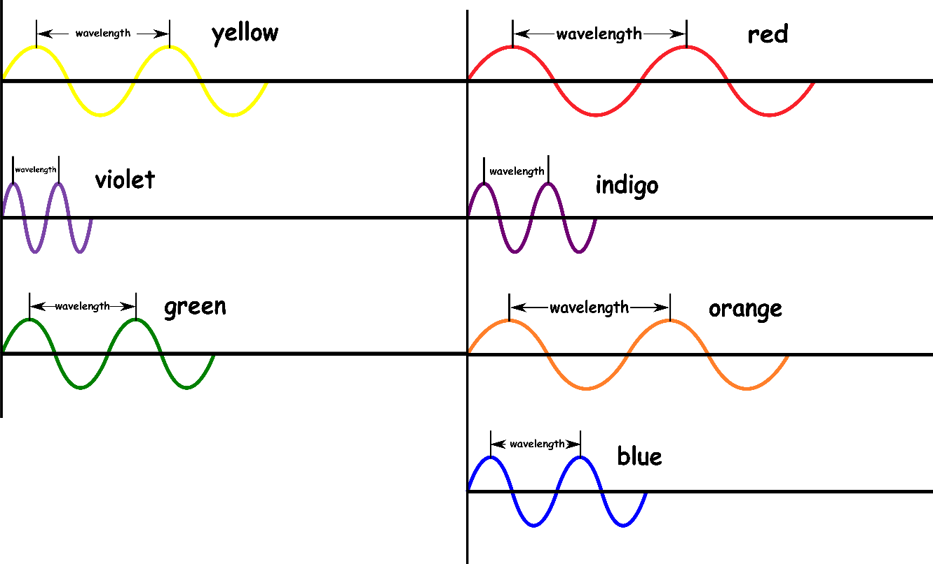
Write down the date and today’s title
DISPERSION AND COLOUR
DO IT NOW; Arrange the colours of the visible spectrum from longest to shortest wavelength. You might have to estimate.
Sequence on click
in slide show.
Stretch
White light contains all the colours of the spectrum. We can show this using a prism as shown above.
What would happen if another prism recombines the light?

Slide 2
SUMMARY
The different colours of light have different wavelengths.
White light contains the seven colours of the spectrum. It can be dispersed using a prism because the different colours are refracted by different amounts.
Objects look a certain colour because they reflect that colour of light but absorb all other colours.
Filters only allow certain colours of light through e.g. a red filter red light, a green filter green light etc.

