Slide 1
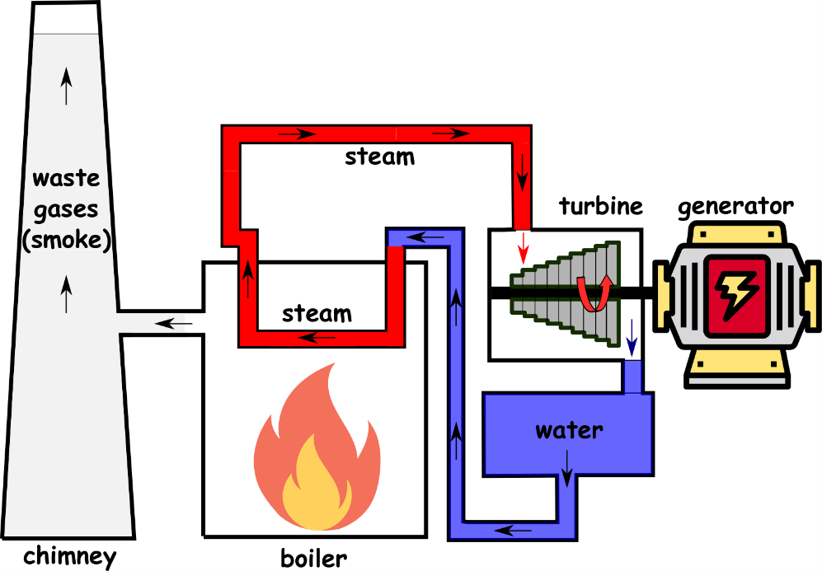
Write down the date and today’s title
FUELS AND ENERGY RESOURCES
DO IT NOW; Put the statements in the correct order to explain how a conventional power station works. Use the image opposite to help.
Statements
Fuel is burned
Water is heated
This creates steam
Steam turns a turbine
Turbine is connected to a generator
Generator produces a voltage
Statements
Water is heated
Steam turns a turbine
Fuel is burned
Turbine is connected to a generator
This creates steam
Generator produces a voltage
Conventional power station
Sequence on click
in slide show.
Stretch
Conventional power stations often burn fossils fuels such as coal and gas. What are some of the problems with this way of generating electricity? CO₂ contributes to global warming/acid rain/pollution
Stretch
Conventional power stations often burn fossils fuels such as coal and gas. What are some of the problems with this way of generating electricity?
Notes:
Statements are out of order underneath. See slide show.

Slide 2
SUMMARY
At present most of the world’s electricity is generated by burning fossil fuels.
Fossil fuels and nuclear are non-renewable and will run out one day.
Burning fossil fuels contributes to global warming.
Renewables don’t run out and don’t contribute to global warming.
Both renewables and non-renewables have advantages and disadvantages such as ………………………………

