Slide 1
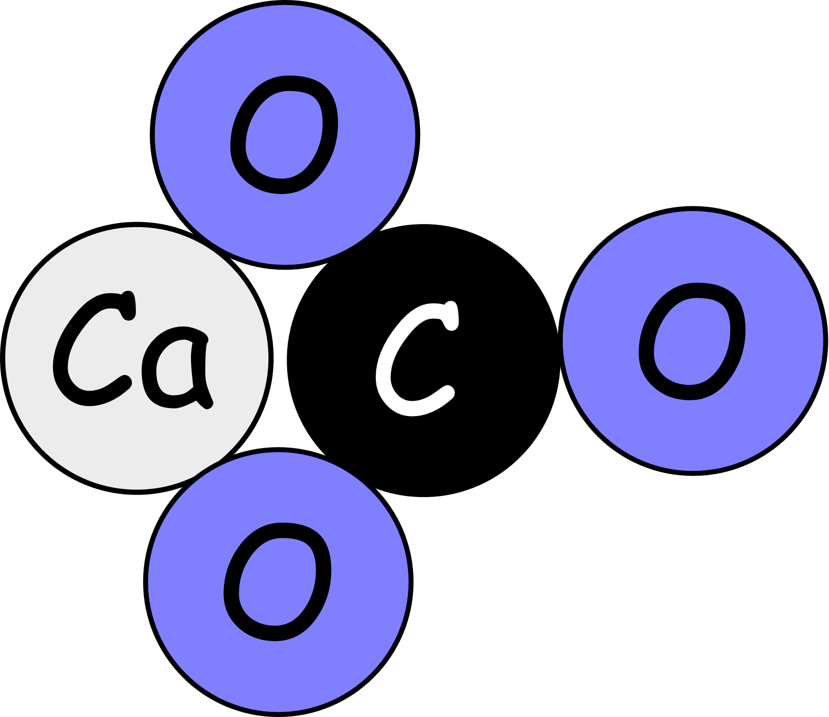
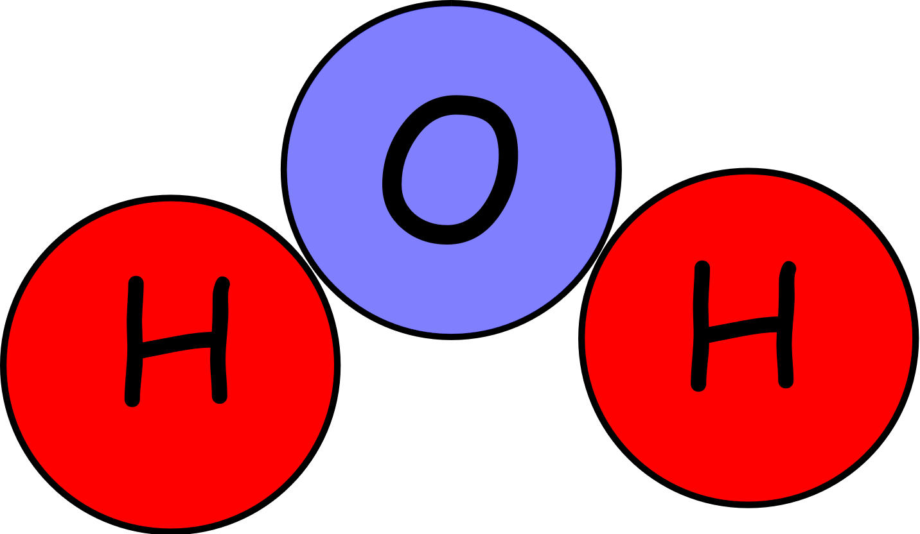
Write down the date and today’s title
CHEMICAL SYMBOLS AND FORMULA
DO IT NOW; Write down the formulae below and match them to the diagrams 1 to 6.
Formulae
CH₄
CO
H₂O
FeO
CaCO₃
N₂
Sequence on click
in slide show.
1.
2.
3.
4.
5.
6.
Stretch
Can you match the formula to the chemical names below?
Nitrogen/Carbon monoxide/Methane/Iron oxide/ Calcium carbonate/Water
Can you say where you might find the above chemicals?

Slide 2
SUMMARY
A chemical formula can be written for any substance.
A chemical formula tells us how many atoms of each element make up a molecule of the substance.
The subscript (numbers written below) tells us how many of each atom e.g. the two in H₂O means two hydrogen atoms in a molecule of water.
No subscript number means one atom of that element is present.

