Slide 1
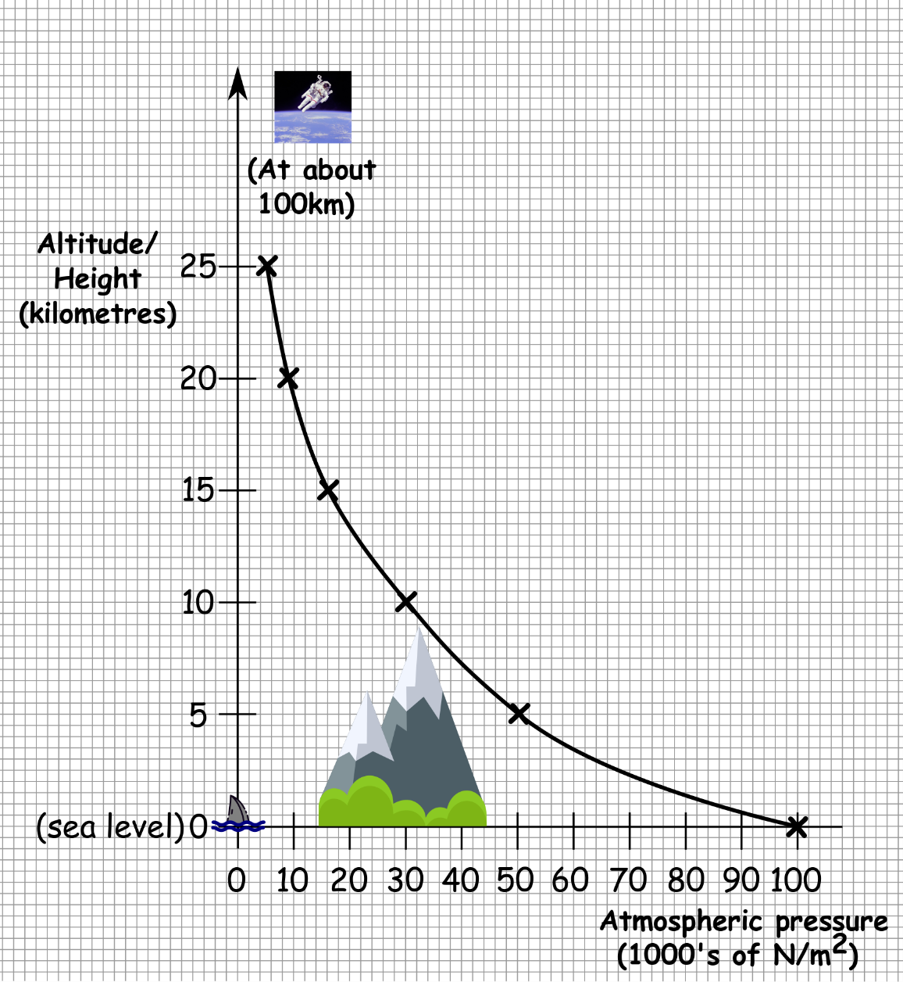
Write down the date and today’s title
ATMOSPHERIC PRESSURE
DO IT NOW; Write down what you think the graph is showing?
Stretch
1. What is the pressure at 5 km high?
2. If the mountain below is Mount Everest, roughly how high is it?
3. What starts at about 100km?
Stretch
1. 50,000 N/m² or 50 (1000’s of N/m²)
2. If the mountain below is Mount Everest, roughly how high is it?
3. What starts at about 100km?
Stretch
1. 50,000 N/m² or 50 (1000’s of N/m²)
2. Roughly 9000m (8848m exactly)
3. What starts at about 100km?
Stretch
1. 50,000 N/m² or 50 (1000’s of N/m²)
2. Roughly 9000m (8848m exactly)
3. Outer space (no atmosphere)
Notes:
Optional balloon pressure video.

Slide 2
SUMMARY
Atmospheric pressure is due to the large weight of air above us.
The weight of a 10 mile high column of air, 1m² in area is 100,000N. This means air pressure on the ground is 100,000N/m².
Atmospheric pressure decreases with height as there is less weight of air above us. The air is thinner.
The large forces exerted by atmospheric pressure can be demonstrated with the collapsing can experiment and the Magdeburg hemispheres.
16 horses couldn’t separate the hemispheres because of the huge force from the weight of air pushing them together.

