Slide 1
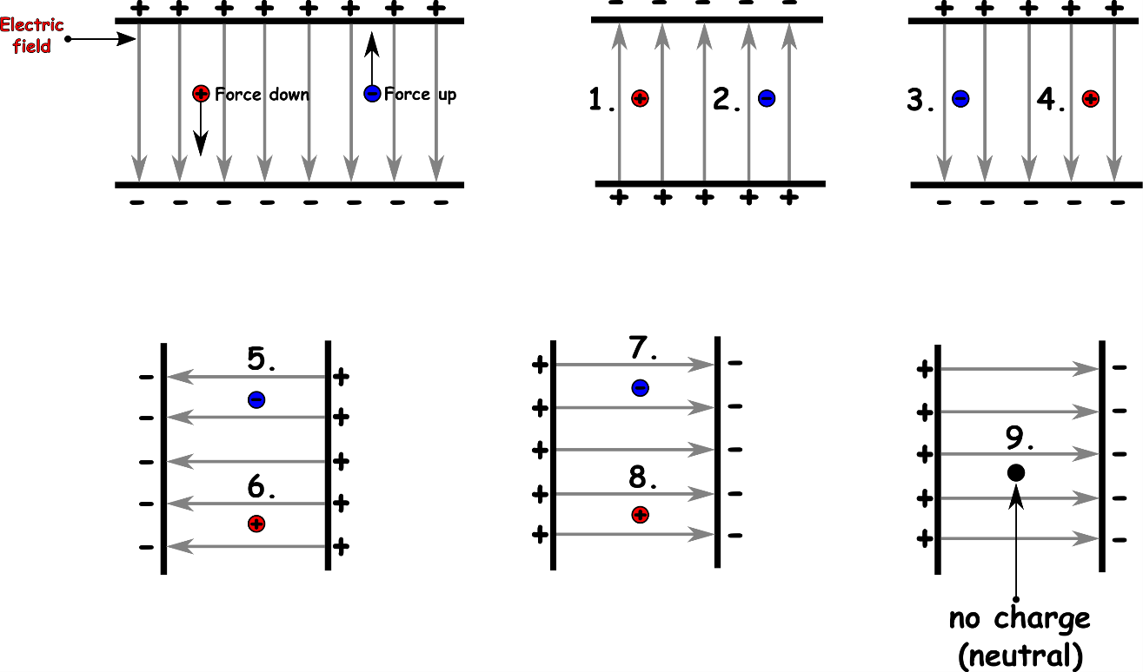
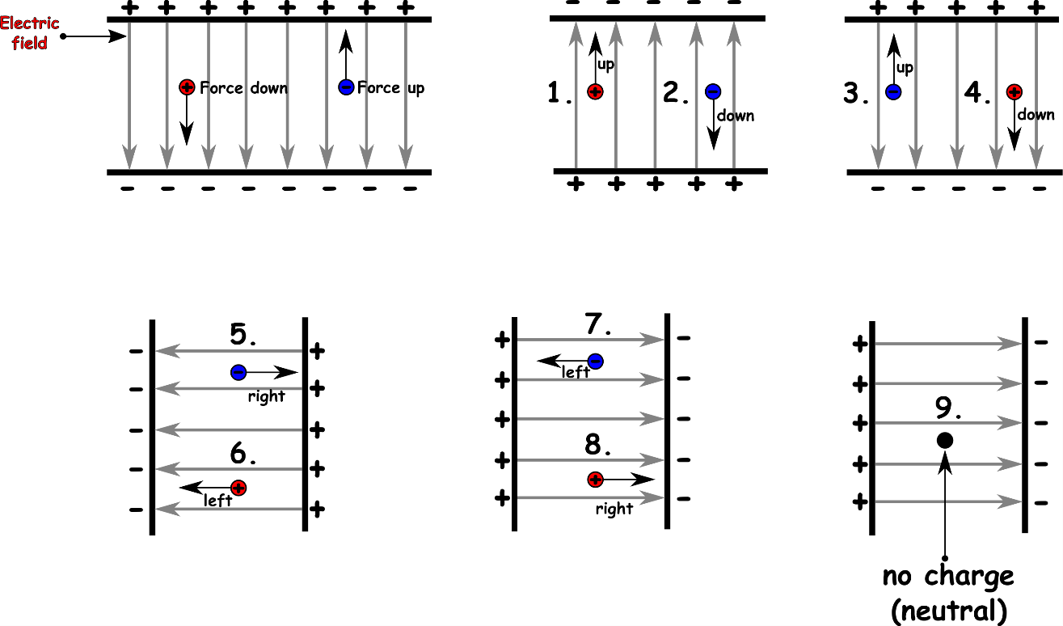
Write down the date and today’s title
ELECTRIC FIELDS
DO IT NOW; Just like gravitational fields (gravity) exerts forces on things with mass, electric fields exert forces on things with charge. Say which way the charges move (up, down, left, right) in the electric fields below. Remember + and + repel (so do – and -) and + and – attract.
Use zoom function.
Sequence on click
in slide show.
Stretch
Electric fields can be strong enough to make electric sparks (electricity flowing through the air). When do we experience this?
Stretch
Electric fields can be strong enough to make electric sparks (electricity flowing through the air). When do we experience this? lightning
Notes:
Questions appears in slide show.

Slide 2
SUMMARY
Electric fields exist around charges.
If charges enter electric fields they experience a force.
Opposite charges attract each other (+ and -).
Like charges repel (+ and + or – and -).
Strong electric fields can make the air conduct electricity giving us a spark.
Electric fields hold atoms and molecules together.

