Slide 1
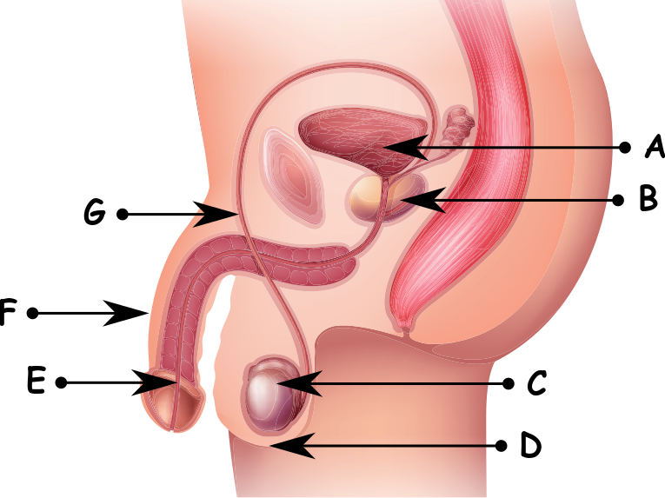
Write down the date and today’s title
REPRODUCTION IN HUMANS; MEN
DO IT NOW; Write down A, B, C, D, E, F and G. How many of a man’s reproductive organs can you match to the letter?
Scrotum
Sequence on click
in slide show.
Penis
Sperm duct
Urethra
Prostate gland
Testes
Bladder
Stretch
Write out the statements below and next to them true or false.
A male can only make a women pregnant when they are both sexually mature.
This normally happens when a man is about 20 years old?
Stretch
Write out the statements below and next to them true or false.
A male can only make a women pregnant when they are both sexually mature. True
This normally happens when a man is about 20 years old?
Stretch
Write out the statements below and next to them true or false.
A male can only make a women pregnant when they are both sexually mature. True
This normally happens when a man is about 20 years old? False.
On ‘average’ around 13 years old for boys and 14 for girls
Notes:
Answers appear in slide show.

Slide 2
SUMMARY
A male becomes sexually mature when he is around 13 years old.
Testosterone is the hormone that males produce in the testes and it stimulates sperm production. Sperm is the male sex cell.
The liquid part of semen is made in the prostate gland and is mixed with sperm from the testes.
If a man and women have sexual intercourse sperm can meet the egg and fertilisation occur. The woman would become pregnant.
Pregnancy lasts around 9 months, the gestation.

