Slide 1
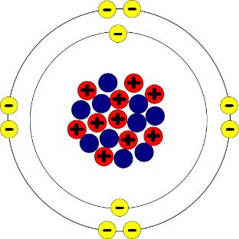
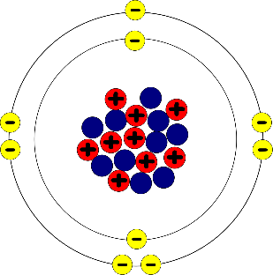
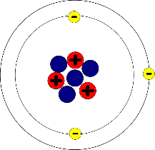
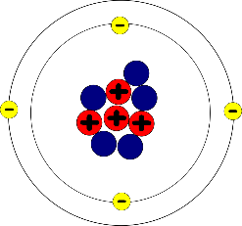
Write down the date and today’s title
PROPERTIES OF G1, G2, G7 AND G8
DO IT NOW; Write out the two sentences below and use the words in bold to complete the gaps.
group, same, electrons, similar, outer
Elements in the same _ _ _ _ _ (column) have _ _ _ _ _ _ _ properties. This is because they have the _ _ _ _ number of _ _ _ _ _ _ _ _ _ in their _ _ _ _ _ shell.
Elements in the same g r o u p (column) have s i m i l a r properties. This is because they have the s a m e number of e l e c t r o n s in their o u t e r shell.
Sequence on click
in slide show.
A.
B.
C.
D.
G1
G8
G2
G7
Stretch
Which group are elements A, B, C and D in? Which is beryllium, neon, lithium and fluorine? Use a periodic table.
Notes:
Answers appear in slide show.

Slide 2
SUMMARY
Elements in the same group have similar properties because they have the same number of electrons in their outer shell.
Group 1 are the alkali metals and react quickly with water producing hydrogen gas and an alkaline solution. They get more reactive down the group.
Group 2 are called the alkali earth metals, they react slowly with water still producing an alkaline solution and hydrogen gas.
Group 7 are called the halogens, famous is chlorine for cleaning our water. They get less reactive down the group.
Group 8 are the noble gases, they are unreactive because they have a full outer shell but do produce light when electricity is passed through them (neon lights).

