Slide 1
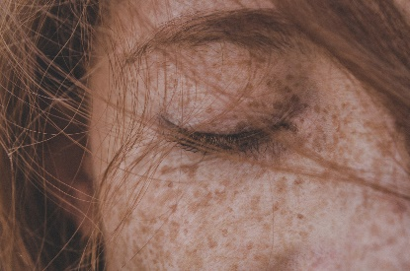
Write down the date and today’s title
GENETICS AND INHERITANCE
DO IT NOW; Characteristics like the length of our eye lashes can be inherited from our parents. List some characteristics which may be inherited. The pictures below help.
Intelligence?
Disabilities
Hair
colour
Height
?
Freckles
Sequence on click
in slide show.
Gender
Eye
colour
Facial features
Stretch
Solve the jumbled clues.
The information for our characteristics is carried by? GESEN
These are found on? COHROMESMOS
These are found in the UUNLECS of a cell.
Stretch
Solve the jumbled clues.
The information for our characteristics is carried by? GENES
These are found on? COHROMESMOS
These are found in the UUNLECS of a cell.
Stretch
Solve the jumbled clues.
The information for our characteristics is carried by? GENES
These are found on? CHROMOSOMES
These are found in the UUNLECS of a cell.
Stretch
Solve the jumbled clues.
The information for our characteristics is carried by? GENES
These are found on? CHROMOSOMES
These are found in the NUCLEUS of a cell.

Slide 2
SUMMARY
We inherit characteristics from the genes of our parents.
Genes are made from DNA molecules. These are found on chromosomes. Humans have 46 chromosomes, 23 from each parent.
Each characteristic has a gene from each parent. The dominant gene (stronger) characteristic is the one that we see.
We can use punnett squares to predict the outcome of combining genes.
X and Y chromosomes determine our sex. XX for a girl and XY for a boy.

