Slide 1
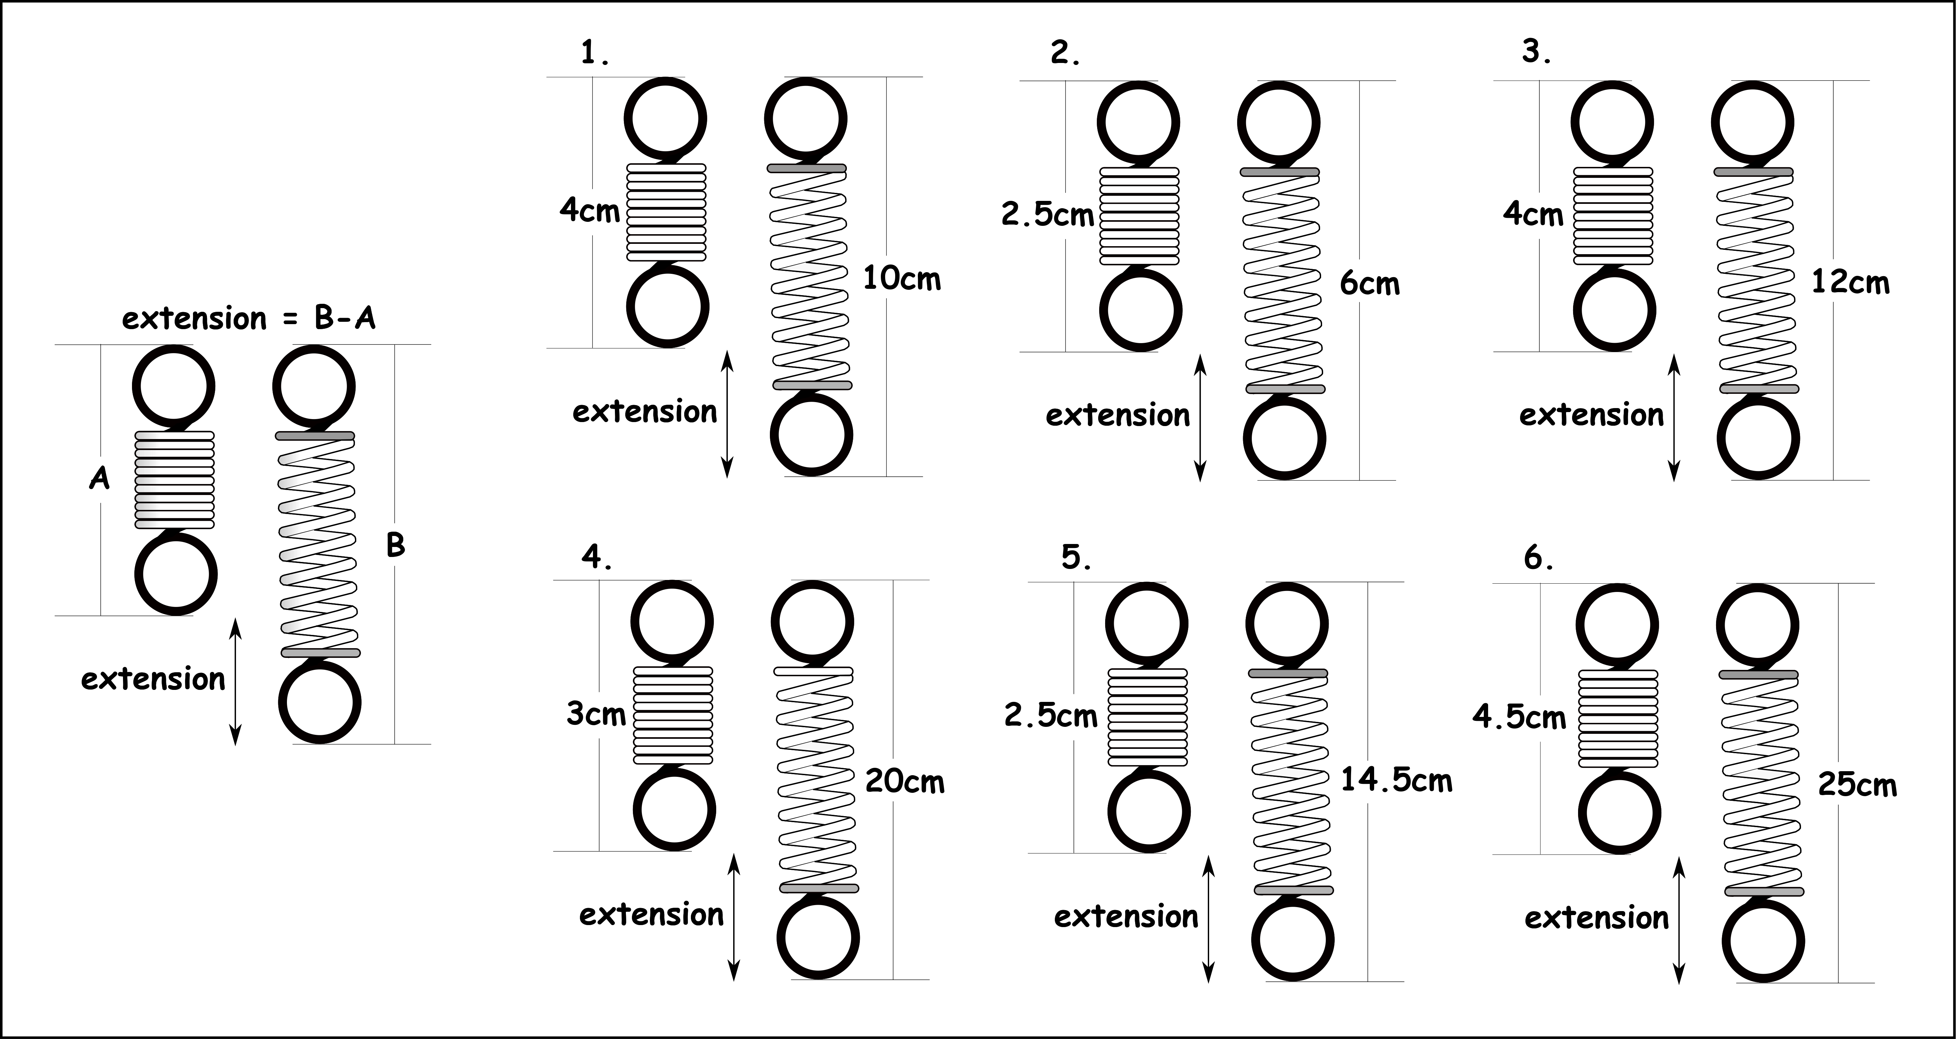
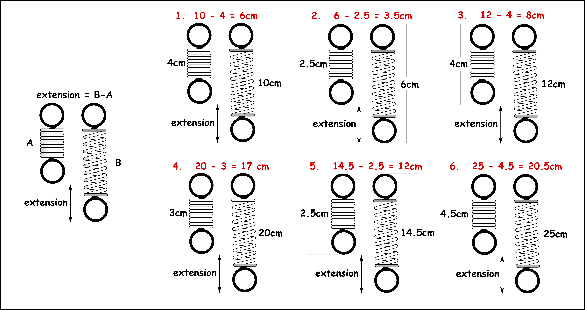
Write down the date and today’s title
HOOKE’S LAW
DO IT NOW; Write down the extension of springs 1 to 6 below. The example on the left shows what to do.
Use zoom function in slide show.
Sequence on click
in slide show.
Stretch
Work out the extensions below.
1. A force of 2N gives extension of 5cm. A force of 4N gives extension of ? cm.
2. A force of 6N gives extension of 2cm. A force of 12N gives extension of ? cm.
Which is the more difficult spring to stretch. 1 or 2?
What is this sort of relationship called?
Stretch
Work out the extensions below.
1. A force of 2N gives extension of 5cm. A force of 4N gives extension of 10 cm.
2. A force of 6N gives extension of 2cm. A force of 12N gives extension of ? cm.
Which is the more difficult spring to stretch. 1 or 2?
What is this sort of relationship called?
Stretch
Work out the extensions below.
1. A force of 2N gives extension of 5cm. A force of 4N gives extension of 10 cm.
2. A force of 6N gives extension of 2cm. A force of 12N gives extension of 4 cm.
Which is the more difficult spring to stretch. 1 or 2?
What is this sort of relationship called?
Stretch
Work out the extensions below.
1. A force of 2N gives extension of 5cm. A force of 4N gives extension of 10 cm.
2. A force of 6N gives extension of 2cm. A force of 12N gives extension of 4 cm.
Which is the more difficult spring to stretch. 1 or 2? 2 is more difficult.
What is this sort of relationship called?
Stretch
Work out the extensions below.
1. A force of 2N gives extension of 5cm. A force of 4N gives extension of 10 cm.
2. A force of 6N gives extension of 2cm. A force of 12N gives extension of 4 cm.
Which is the more difficult spring to stretch. 1 or 2? 2 is more difficult.
What is this sort of relationship called? Directly proportional.
Notes:
Answers appear in slide show. Use zoom function for clarity.

Slide 2
SUMMARY
Hooke’s law tells us the way that some objects stretch (extend) or squash (compress).
Objects that stretch or squash in proportion to the force are said to obey Hooke’s law.
If an object is stretched and then returns to its original length when the force is removed, we call this elastic behaviour.
If an object stays stretched we call it plastic behaviour.
Springs obey Hooke’s law but can be overstretched past their elastic limit, they then stay permanently stretched.

