Slide 1
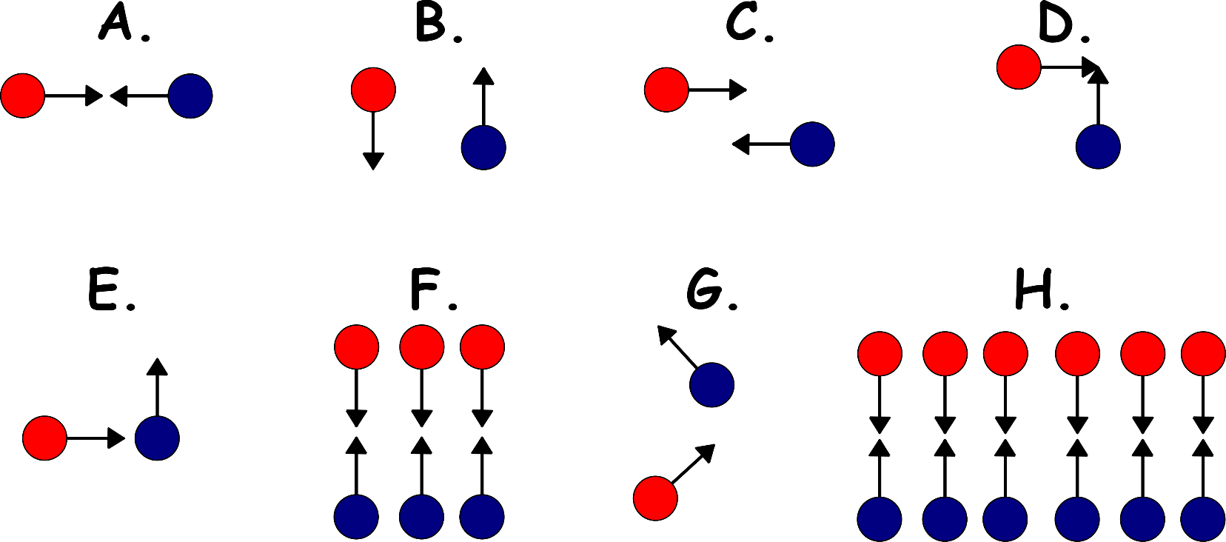
Write down the date and today’s title
REACTION RATES AND CATALYSTS
DO IT NOW; Particles (red and blue) must collide to react. Write down which of the examples A to H will produce a reaction.
Yes
Yes
No
No
Sequence on click
in slide show.
Yes
No
No
Yes
Stretch
If the product of the reaction between red and blue is a gas, which will produce the most gas?
How could we measure a gas given off from a reaction?
Stretch
If the product of the reaction between red and blue is a gas, which will produce the most gas? H, most collisions, most product
How could we measure a gas given off from a reaction?
Notes:
Questions appears in slide show.

Slide 2
SUMMARY
Collision theory tells us that particles must collide to react.
More collisions per second means a faster reaction.
This can be achieved by;
A higher concentration, meaning…
A higher temperature, meaning…
A greater surface area meaning…
The rate of a reaction can be measured by the decrease in mass over time or the amount of gas produced over time.
Catalysts are substances that can be added to chemical reactions to speed them up. They reduce the energy that two colliding particle must have to produce a reaction.

