Slide 1
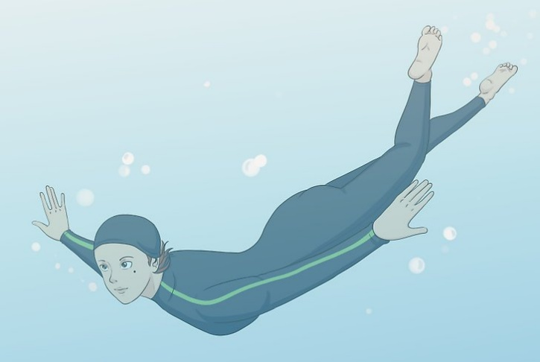
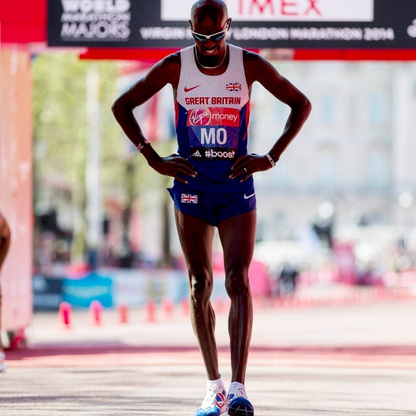
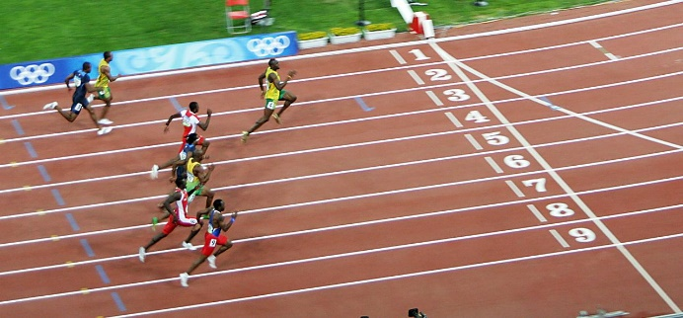
Write down the date and today’s title
AEROBIC AND ANAEROBIC RESPIRATION
DO IT NOW; Describe how you think the breathing is different in the three activities below.
Sequence on click
in slide show.
Running 100m
Swimming underwater
Running a marathon
Stretch
When you exercise intensely (a lot in a short time) what do you notice happens to your muscles? Ache/hurt/burn
What is the name given to a chemical that can burn the skin?
Stretch
When you exercise intensely (a lot in a short time) what do you notice happens to your muscles? Ache/hurt/burn
What is the name given to a chemical that can burn the skin? Acid
Stretch
When you exercise intensely (a lot in a short time) what do you notice happens to your muscles?
What is the name given to a chemical that can burn the skin?

Slide 2
SUMMARY
We breathe to supply the cells of our body with the oxygen they need.
A chemical reaction called respiration between oxygen and glucose in our cells releases energy. The products are………………………………….
Respiration can happen with (Aerobic) or without (Anaerobic) oxygen.
Without oxygen lactic acid is produced which causes muscle burn.
Aerobic respiration of yeast is used in baking to make bread rise.
Anaerobic respiration is used in brewing to make alcohol.

