Slide 1
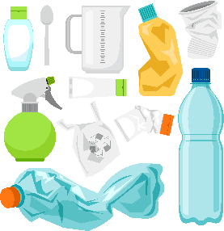
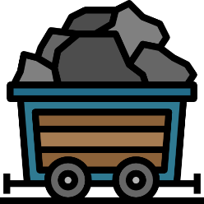
Write down the date and today’s title
EARTH’S LIMITED RESOURCES AND OUR RESPONSIBILITIES
DO IT NOW; Write down why you think the resources below should be used wisely. Think of words like; limited, pollution, energy, money, environment
Water
Metal
Plastics
Sequence on click
in slide show.
Fossil fuels
Natural gas
Coal
Oil
Stretch
What gas does burning fossil fuels produce?
Why is this bad for the environment?
Stretch
What gas does burning fossil fuels produce? Carbon dioxide
Why is this bad for the environment?
Stretch
What gas does burning fossil fuels produce? Carbon dioxide
Why is this bad for the environment? Contributes to global warming

Slide 2
SUMMARY
The carbon cycle shows us that human consumption, deforestation and the burning of fossil fuels means there is too much CO₂ entering the atmosphere.
The earth has limited resources. Oil is an important limited resource, it can be used to make products such as plastics, extremely useful.
Plastics need to be recycled because they are not biodegradable and too much plastic is ending up in our seas.
Metals used in batteries such as lithium and cobalt are in limited supply. As countries move to electric vehicles the chemicals in these batteries will need to be recycled.
Clean water is a valuable resource with millions around the world not having enough, it should be used wisely.

