Slide 1
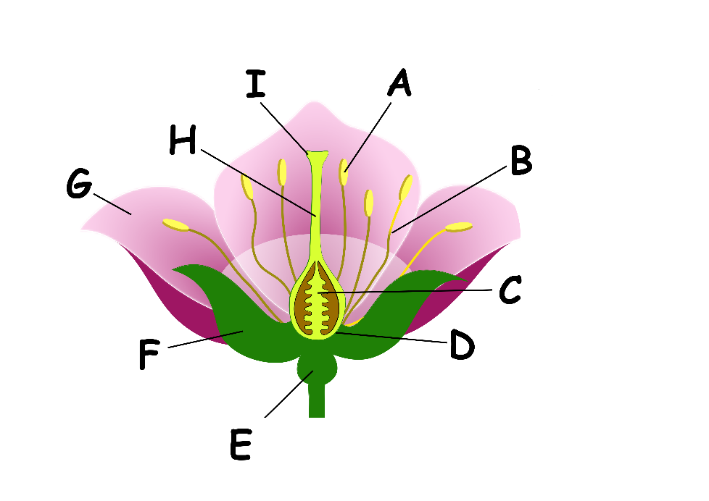
Write down the date and today’s title
REPRODUCTION IN PLANTS
DO IT NOW; The different parts of a flowering plant are shown below. Two letters of each part are given. Work out the name of parts A to I.
NAMES
OVULE
RECEPTACLE
FILAMENT
ANTHER
PETAL
STIGMA
STYLE
OVARY
SEPAL
(TG)
STIGMA
ANTHER
(AH)
(SY)
STYLE
(FT)
FILAMENT
PETAL
Sequence on click
in slide show.
(PL)
(OU)
OVULE
(SL)
SEPAL
(OA)
OVARY
RECEPTACLE
(RP)
Stretch
Most new plants start from a seed, how can seeds spread?
Wind, water (rivers), carried by animals and pods exploding
What are seeds often found in?
Stretch
Most new plants start from a seed, how can seeds spread?
Wind, water (rivers), carried by animals and pods exploding
What are seeds often found in? fruits
Stretch
Most new plants start from a seed, how can seeds spread?
What are seeds often found in?
Notes:
Answers appear in slide show.

Slide 2
SUMMARY
Plants that produce a flower reproduce sexually.
This means the male sex cell, pollen, must fuse with the female sex cell called the ovule.
To increase their chances of being pollinated, flowers produce nectar, scents and have bright colours to attract insects.
Seeds can be spread by wind, water (rivers/seas), animals and explosions!
Seeds germinate (begin to grow) and new plants are formed.

